Slide 1

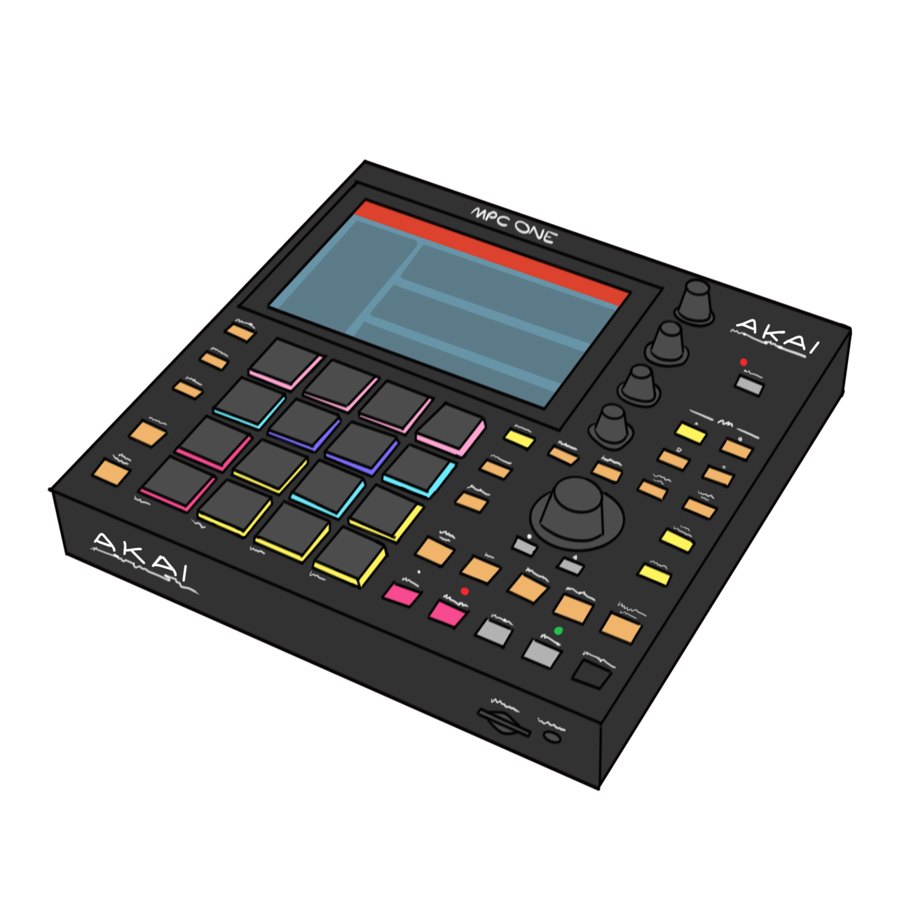
sampleD. . . .
A music remix competition
By Konnen Hannaford

Slide 2
ELEVATOR PITCH….
SAMPLED WILL ALLOW USERS TO POST REMIXES OF SONGS USING A. SELECT LIST OF SAMPLES AND POST IN A WEEKLY COMPETITION

Slide 3
CONCEPT STORY….
MUSIC PRODUCTION HAS BECOME SO MUCH MORE POPULAR
OTHER COMPETITIONS OF THIS TYPE HAVE GENERATED A LOT OF FOLLOWERS FOR ARTISTS
THIS COULD BE A GREAT NETWORKING OPPORTUNITY AS WELL AS FOR BIGGER ARTISTS TO ENGAGE WITH FANS.

Slide 4
PROCESS…
INITIAL IDEA - FURTHER DEVELOPMENT
STRUGGLES WITH GRAPHQL AND APOLLO
Hope to make this a properly functioning service

Slide 5
Tools used….
Apollo 3
MONGO
Express
React
GRAPHQL
HOWLER
CHAKRA
REACT-ICONS

Slide 6
Issues faced….
Future developments…
Lack of understanding
Apollo issues
Chakra issues
Reduced scope

Slide 7
positives….
Future developments…
React familiarity
graphql
Can take this forward
Music file upload to play
Cloud services
Developing winners page and database

Slide 8
Demo….
PresSo time

Slide 9
Links
GitHub
https://github.com/konnenhannaford/battle
HeroKU
https://sampledbattle.herokuapp.com/

